Slide 1
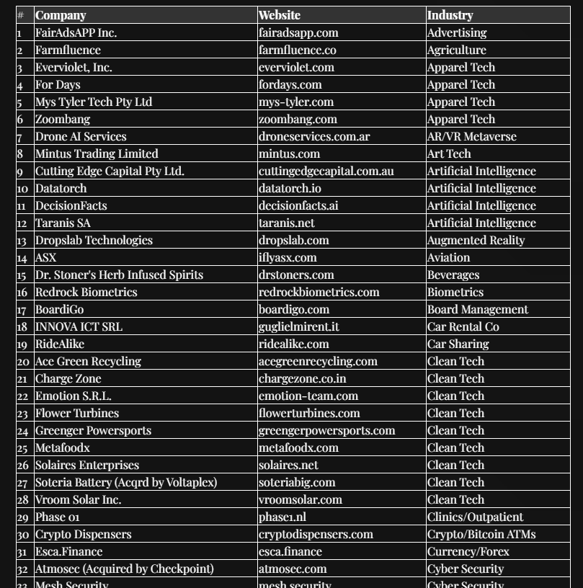


Equity Warrants: Unlocking Value Through Strategic Investments
Owned Equity Warrants
In March 2023, Newchip Accelerator filed for bankruptcy, and by August 2024, its assets, including warrant agreements with were sold to Angel Deal Syndicate, LLC in a court-approved auction.
​
Click here to view full list of 81+ companies that raised $186M+, making the value of our warrants significant.
by Angel Deal Syndicate, LLC

Slide 2

Our Mission and Approach
1
Identify Opportunities
We rigorously research markets and evaluate startups' growth prospects to find valuable equity warrants.
2
Acquire Warrants
We negotiate favorable terms and finance exercise prices to secure warrants under optimal conditions.
3
Execute Strategically
We monitor startup performance and convert warrants into equity at the optimal time to maximize returns.
4
Share the Wealth
We distribute proceeds to investors and reinvest in new opportunities to drive continued growth.

Slide 3

Collaborative Growth Strategy
We view ourselves as stakeholders, not adversaries. Our goal is to empower companies to raise subsequent rounds clear of equity warrant complexities. We offer expertise and reinvestment at par value, creating win-win opportunities.
1
Identify
We select high-potential startups from our portfolio of equity warrants.
2
Collaborate
We engage in positive collaboration, offering expertise and resources.
3
Invest
We exercise warrants and reinvest at par value to support growth.
4
Exit
We aim for successful exits, benefiting both the company and our investors.

Slide 4
Investment Program Benefits
For Startups
For Investors
For the Ecosystem
Access to expertise and resources
Exposure to high-growth potential startups
Increased innovation and job creation
Clear path for future funding rounds
Strategic entry points through warrants
Efficient allocation of capital
Stronger startup ecosystem
Support in achieving growth milestones
Diversified portfolio across industries

Slide 5




Aviation, Biometrics and Apparel Tech
We have equity warrants in aviation, apparel tech and biometrics companies. These include ASX, Redrock Biometric & For Days.
ASX
Manufacturer of electric vertical takeoff and landing (eVTOL) aircraft, connecting cities and suburbs with clean, quiet systems for defense, emergency, cargo, and passenger use.
Redrock Biometrics
Identification software matching palmprints and veins for retail, payments, access control, and password-less sign-ins.
For Days
Apparel manufacturer reducing textile waste through a recycling and rewards platform, offering recyclable, affordable fashion.

Slide 6

Clean Tech and Renewable Energy
Our clean tech portfolio includes Ace Green Recycling, Charge Zone, Flower Turbines, and Vroom Solar Inc. We're excited about the potential in this rapidly growing sector.
Ace Green Recycling
We'll exercise warrants as they expand their lead-acid battery recycling technology globally.
Charge Zone
As India's EV charging infrastructure grows, we'll strategically convert our warrants.
Flower Turbines
We plan to exercise warrants when their unique wind turbine design gains market share.
Vroom Solar
Our warrant strategy aligns with their expansion in the residential solar market.

Slide 7




Health, Food Tech and Environmental
Our health tech warrants include HUB Healthcare, Dr. B Dental Solutions, Pneumeric, Inc., Rocket Wellness Inc. We also have warrants in Metafoodx, Invert Inc and Egal Pads Inc.
Identify Growth
We closely monitor each company's progress in developing and scaling their healthcare solutions.
Strategic Timing
We'll exercise warrants at optimal points, such as major partnerships or market expansions.
Support Scaling
Post-exercise, we'll provide resources and expertise to accelerate growth and market penetration.

Slide 8

Diverse Tech Innovations
Our portfolio spans various tech sectors, including AI: “DecisionFacts” and “Taranis SA.” Cybersecurity: “Atmosec” and “Circadian Risk.”)Supply chain tech: “Gomove” and “Tachyon.”
Sector
Company
Warrant Strategy
AI
Taranis SA DecisionFacts
Exercise as AI adoption increases
Cybersecurity
Circadian Risk
Atmosec
Convert with enterprise client growth
Supply Chain
Tachyon
GoMove
Exercise alongside Series A/B funding

Slide 9
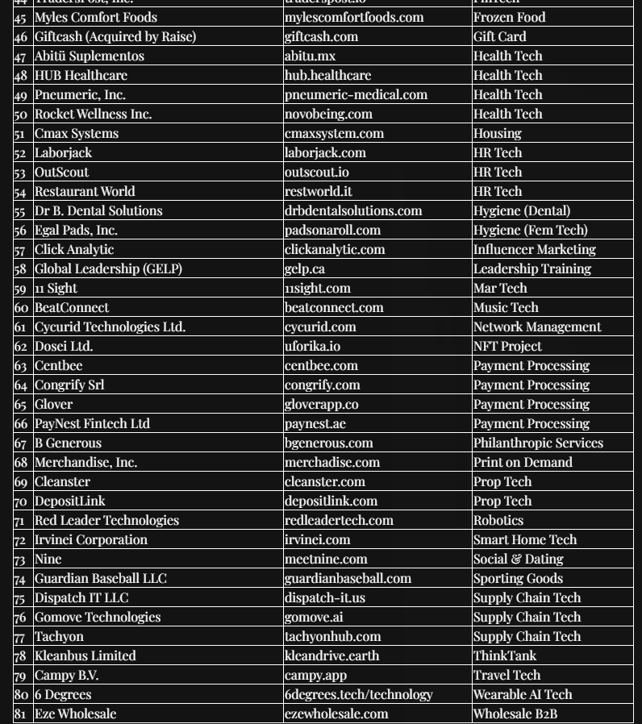
Invest into 81+ previously inaccessible private companies that raised $186M+
Owned Equity Warrants
Whereas these warrants were previously unavailable because they were held by Newchip Accelerator, now they are accessible through Angel Deal Syndicate offering investors a rare opportunity to capitalize on 81+ companies that have collectively raised $186M+.​
Click here and access our “ADV Strategic Warrant Fund SPV” conducting due diligence into 81+ deals.
Val Kleyman | Phone: 732-913-0059 | Email: Val@AdValorem.io
Zoom: Book a Call | Website: https://Angelinvestorwanted.com/warrants

